Slide 1
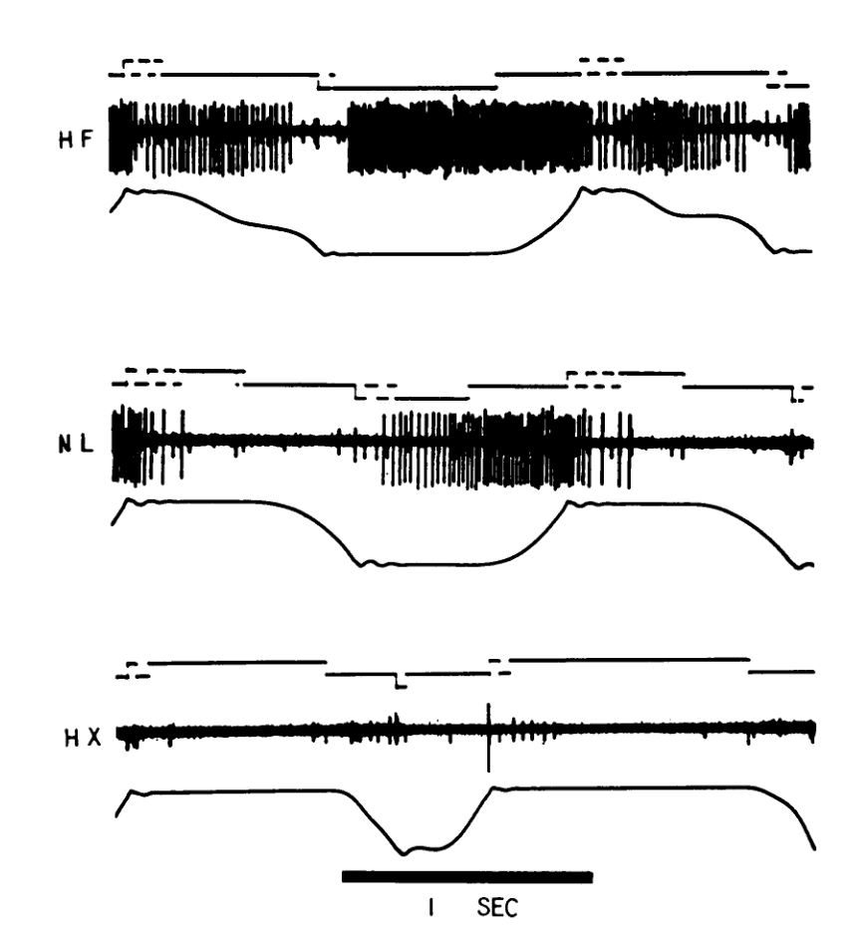
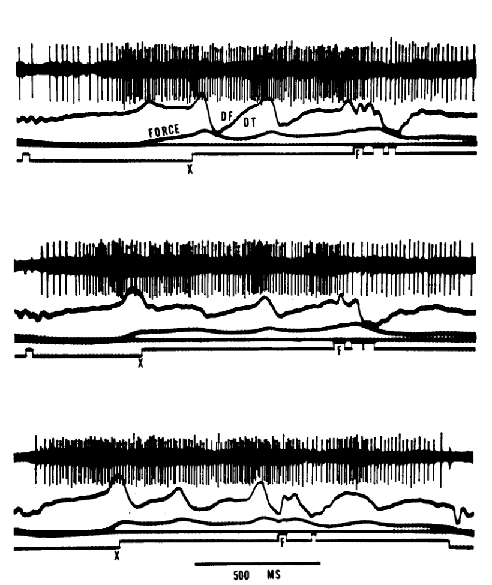
Introduction – The Displacement vs.
Force Debate
• M1 activity was early conceptualized as a direct controller of physical parameters like force magnitude and rate of change (dF/dt).
Evarts J Neurophysiol 1968

Slide 2
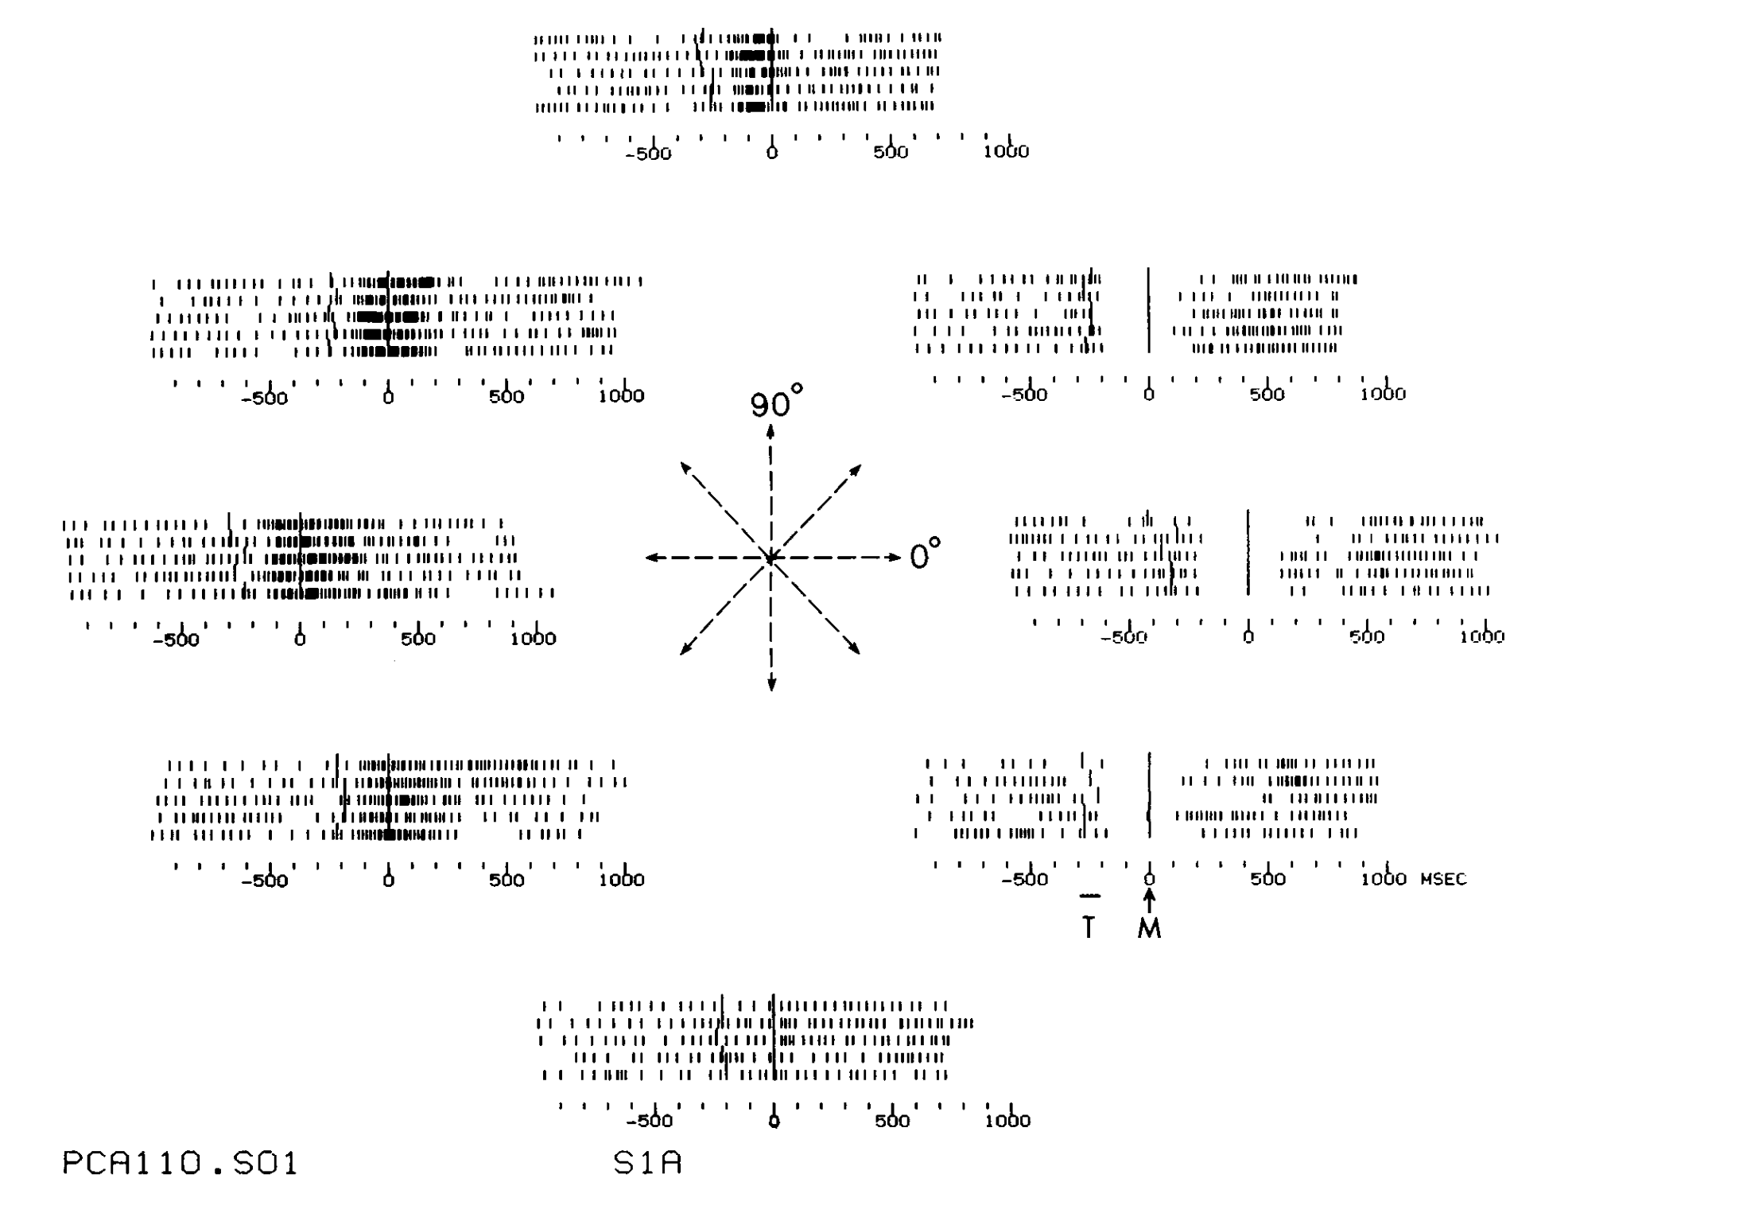
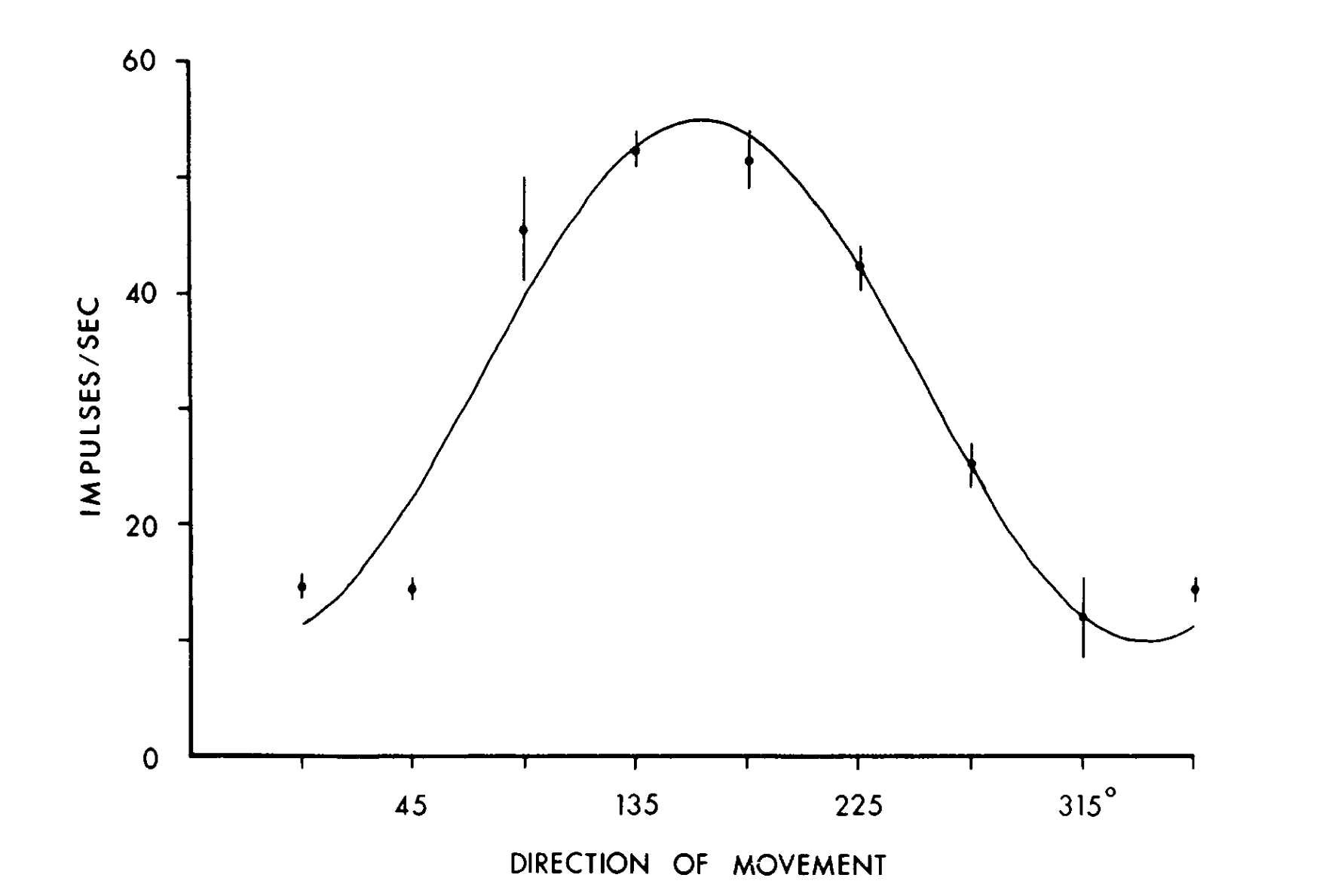
Directional Tuning of Single
Neurons
• Individual M1 cells show broad, sinusoidal tuning curves related to movement direction in 2D and 3D space.
Georgopoulos J Neurosci 1982

Slide 3
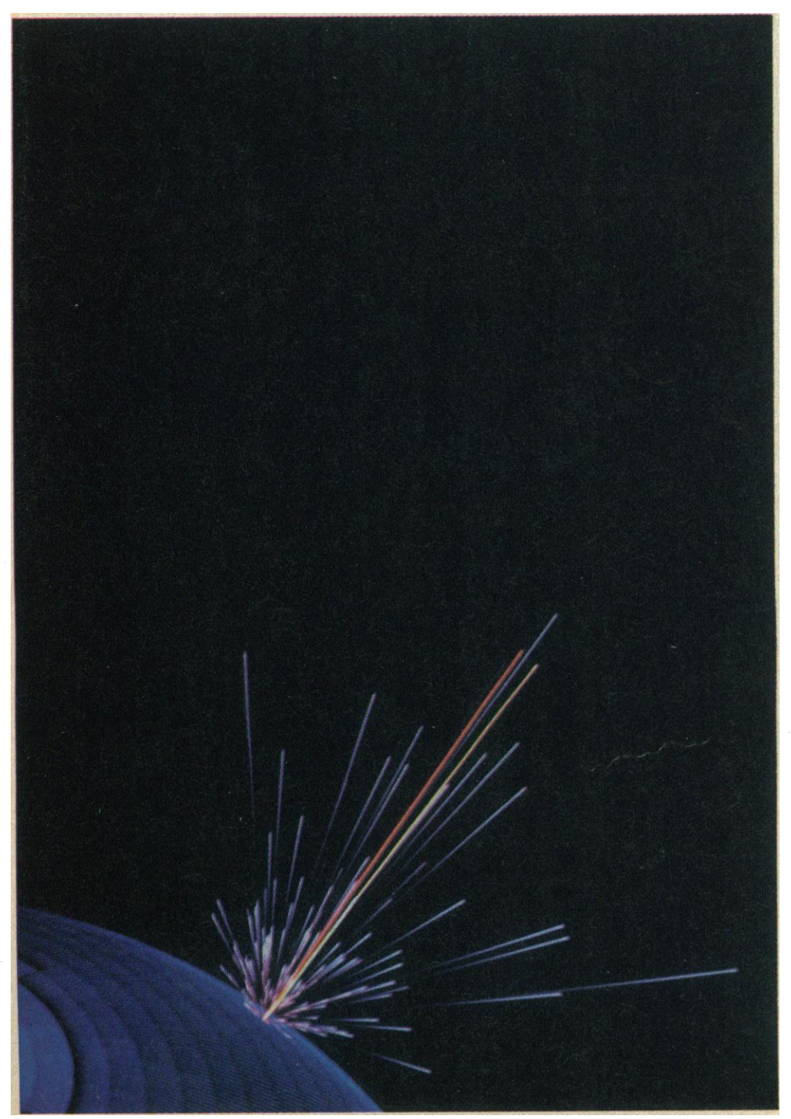
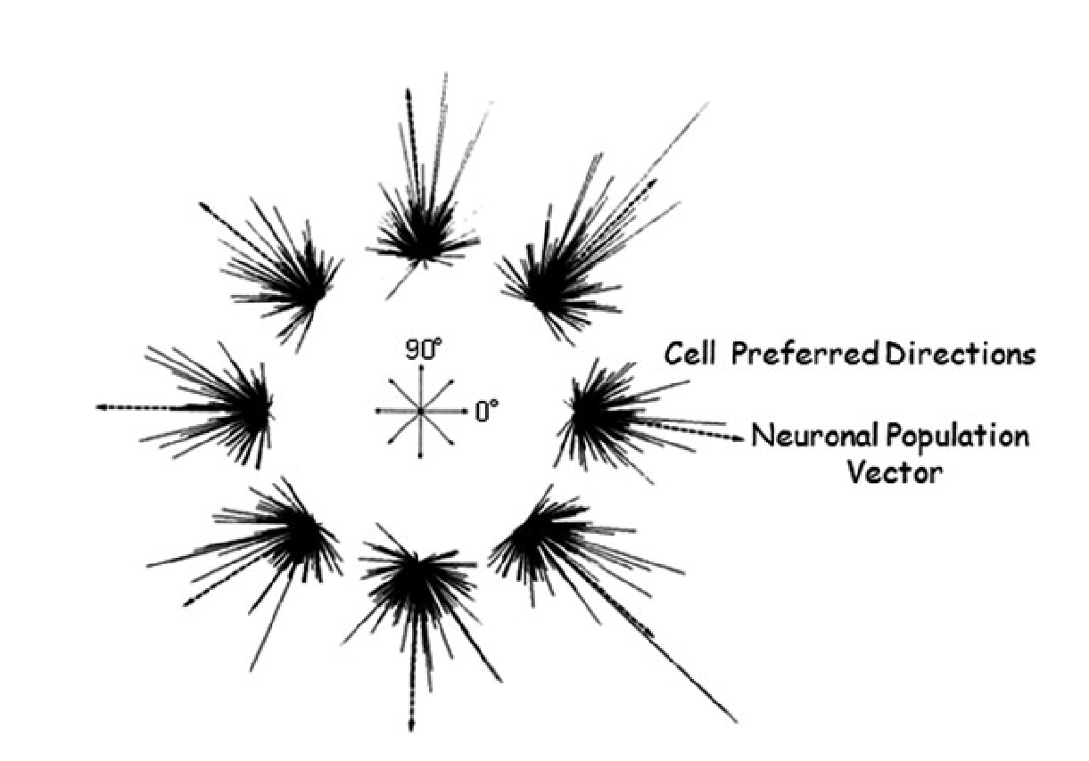
The Population Vector Algorithm
• Directional intent is uniquely predicted by the weighted sum of a population of broadly tuned cells.
Georgopoulos Science 1986

Slide 4
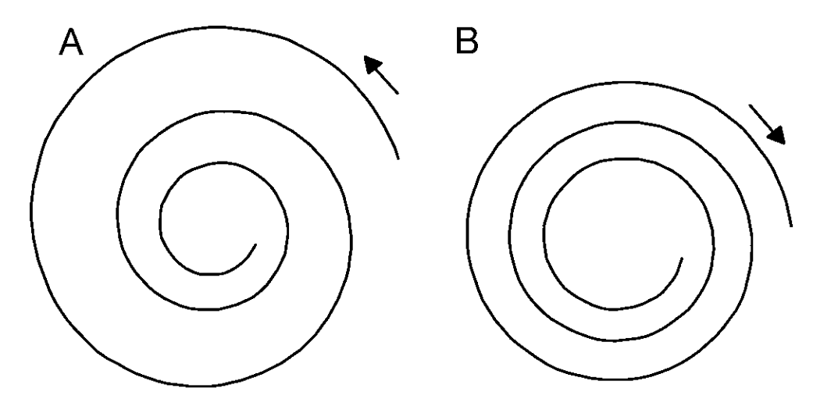
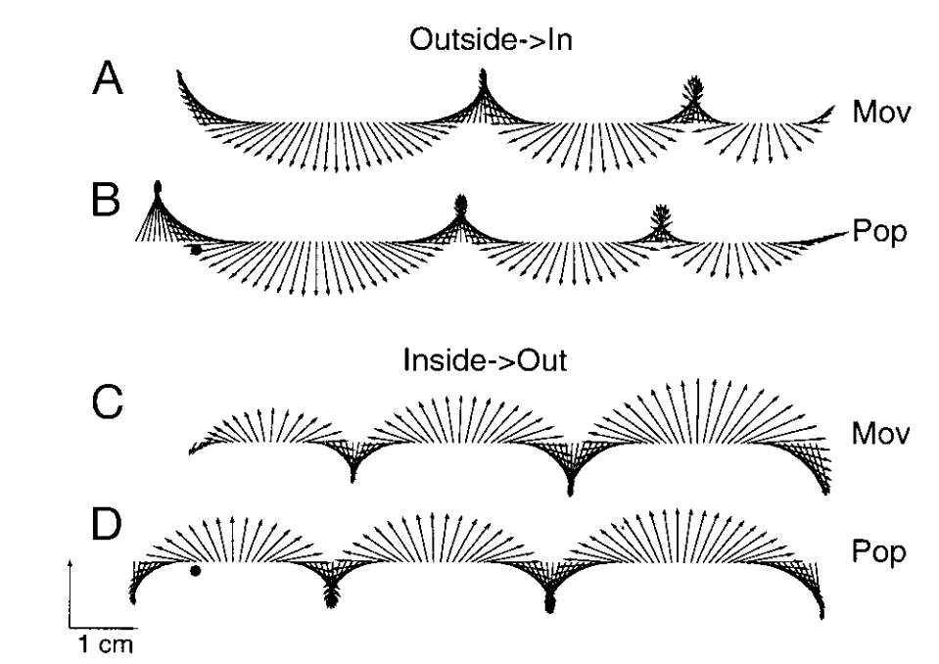
Representing Complex Trajectories
• Population activity can accurately visualize the shape of complex figures, such as spirals, as a movement plan.
Moran J Neurophysiol 1999

Slide 5
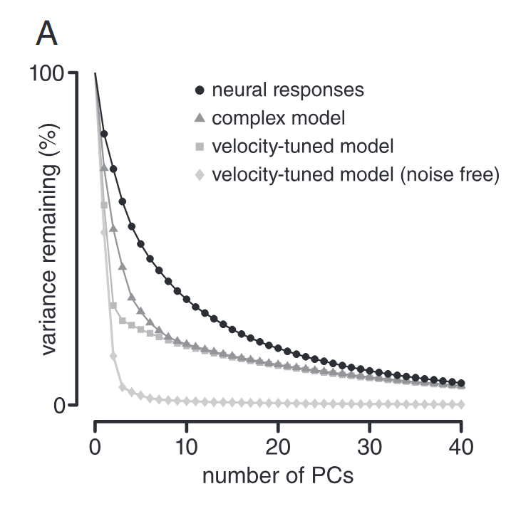
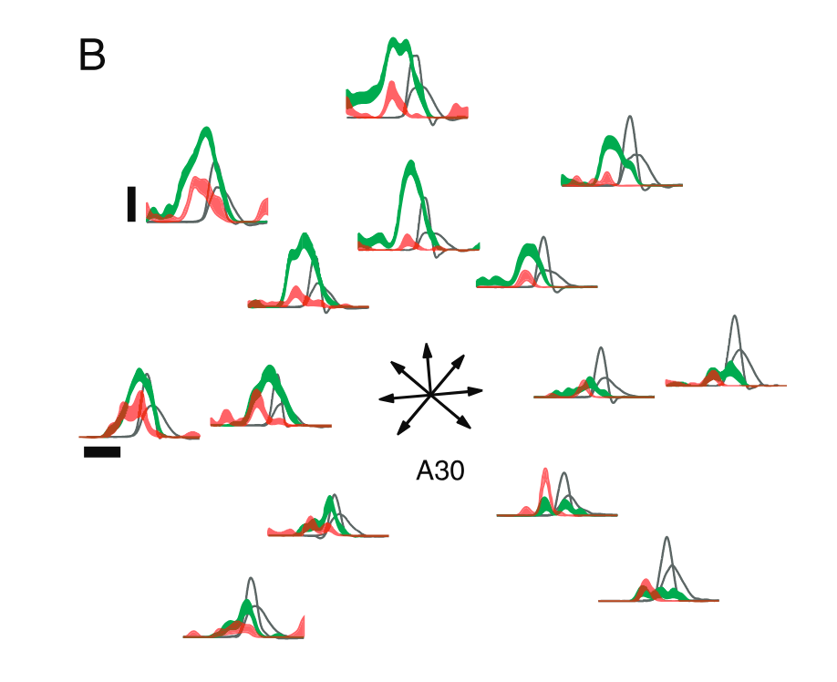
“Inconvenient Truths”: Limits of
Representation
• Tuning magnitude and breadth are not stable; they often change non-linearly when speed or distance varies.
Scott J Physiol 2008

Slide 6
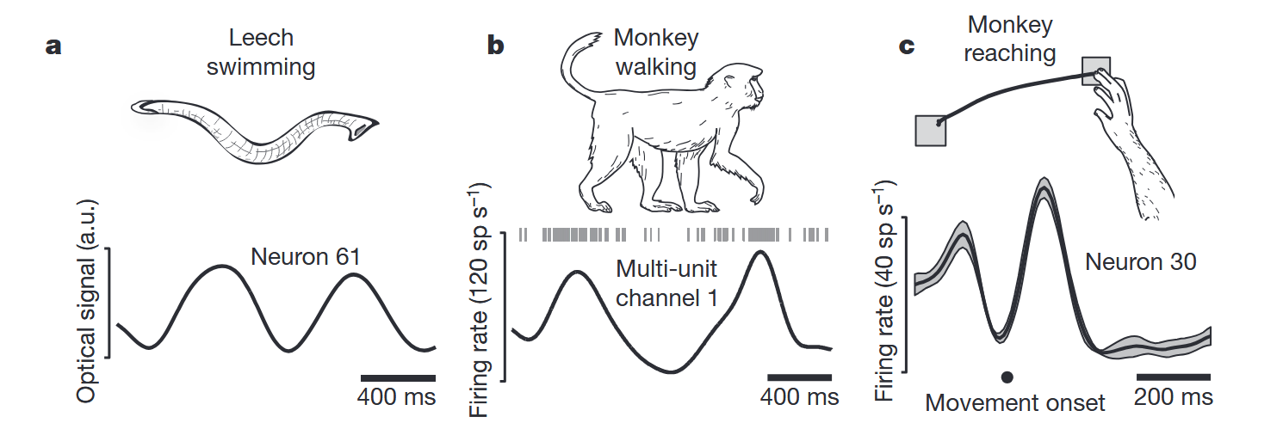
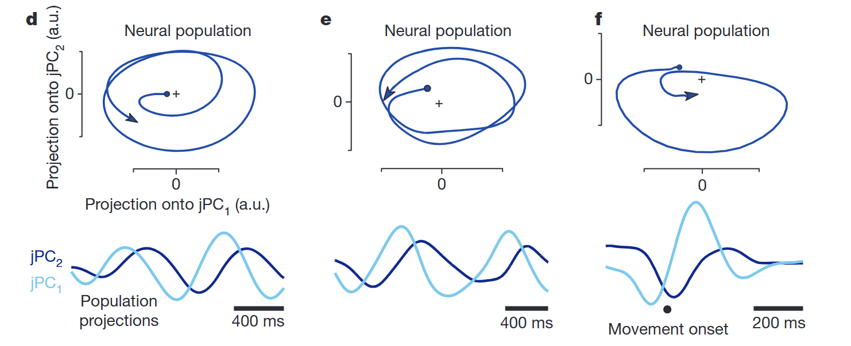
Discovering Rotational Dynamics
(jPCA)
• Population states consistently rotate over time across different species and movement types.
Churchland Nature 2012

Slide 7
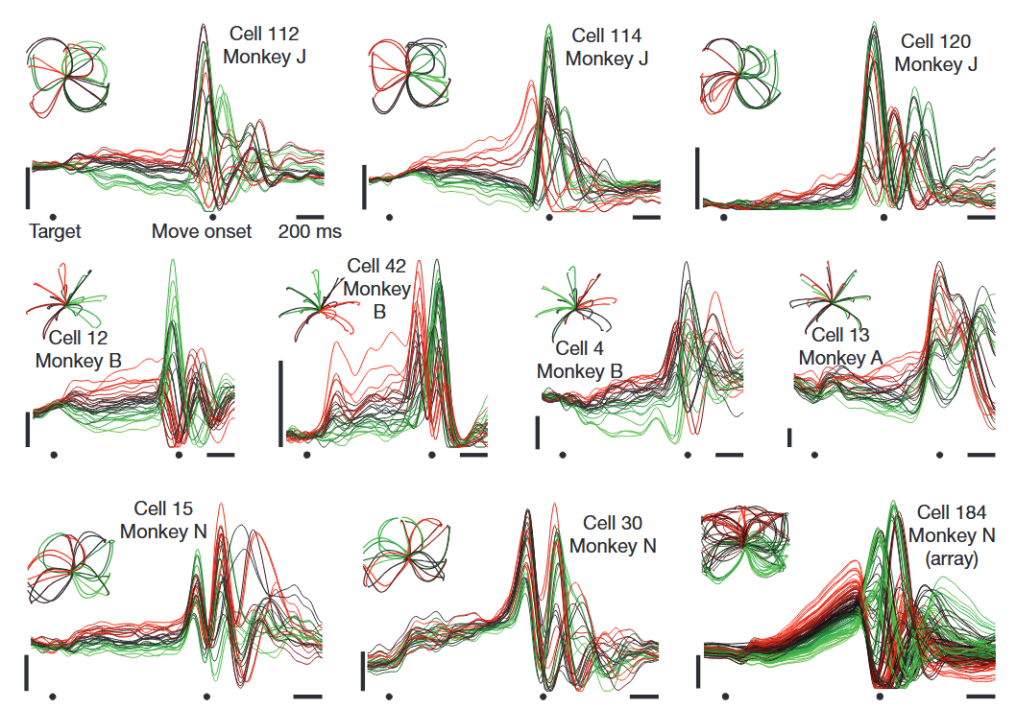
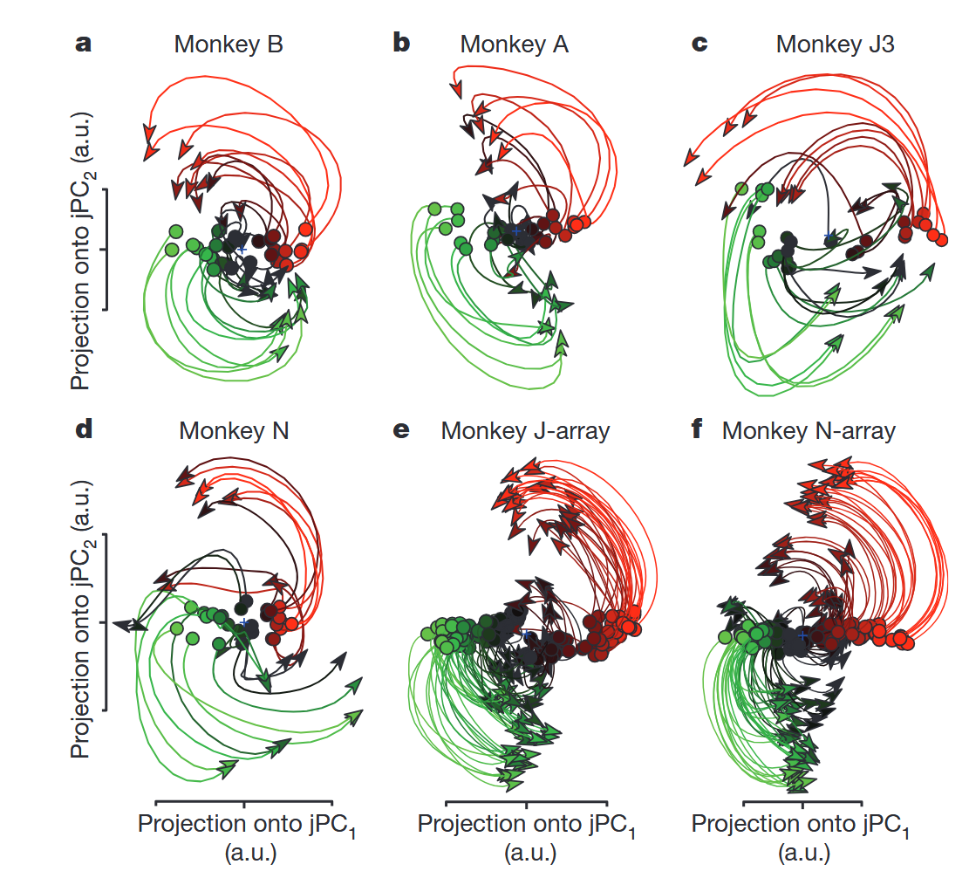
Rotational dynamics in M1 reaching
With the right dimensionality reduction we can see the rotations in neural activity
Churchland Nature 2012

Slide 8
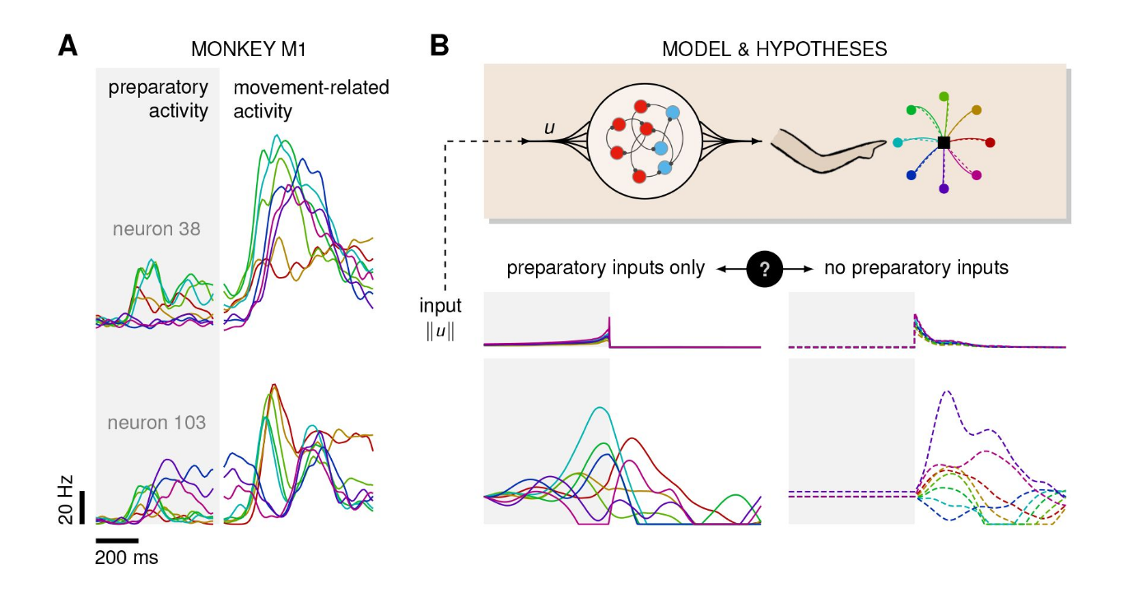
Feedback or feedforward motor control?
Does a trained network model choose feedforward or feedback control of reaching?
Schimel Frontiers Neural Circuits 2023

Slide 9
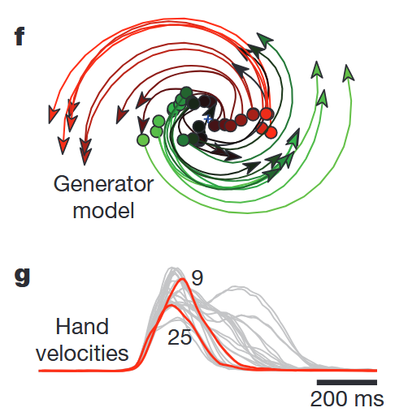
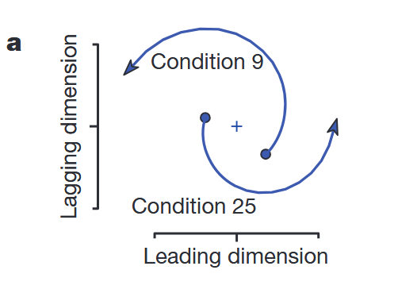
Initial conditions and dynamics drive movement
• Shift from a representational “code” to a dynamical model where orthogonal rotations drive motor output.
Churchland Nature 2012

Slide 10
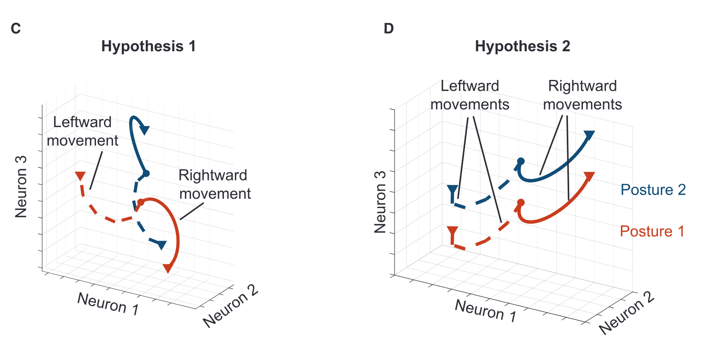
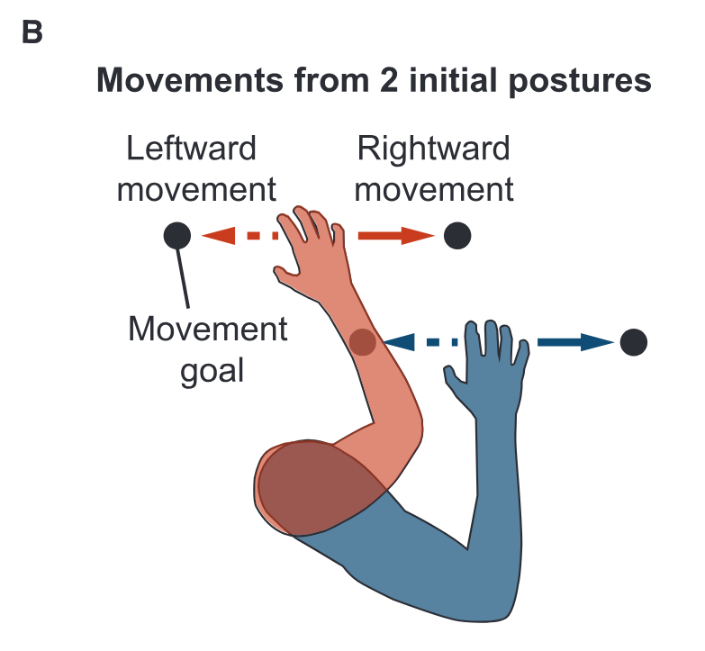
Subspaces for Information
Multiplexing
• The brain partitions activity into orthogonal subspaces to manage distinct signals without interference.
Marino Neuron 2025

Slide 11
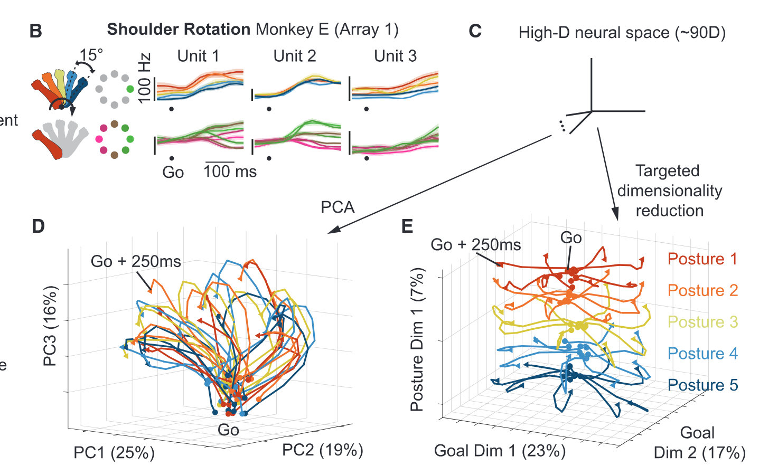
The Posture Subspace
• Changes in arm posture cause a linear “offset” in neural activity, while the shape of reach trajectories remains conserved.
Marino Neuron 2025

Slide 12
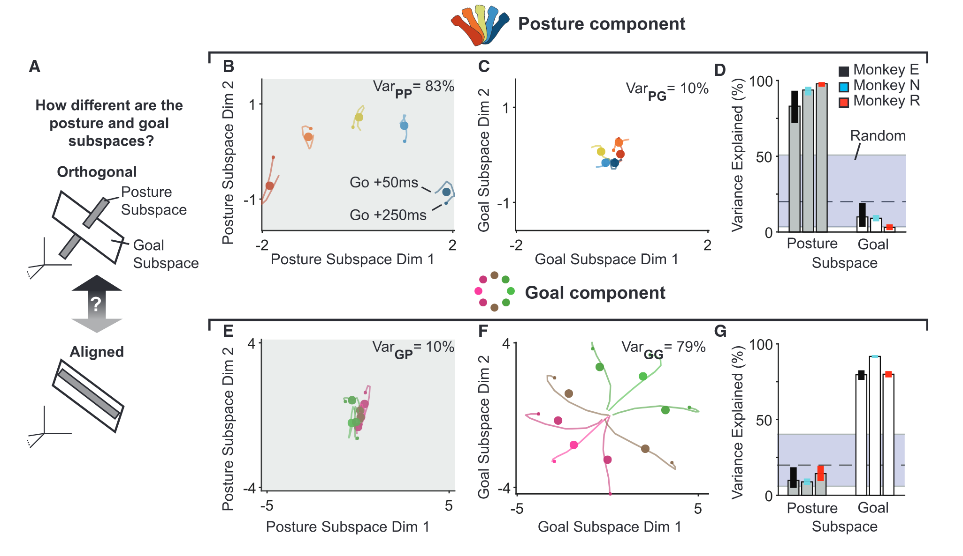
Output-Null vs. Output-Potent
Dimensions
• Sensory feedback and preparatory signals are initially isolated in output-null dimensions to prevent premature movement.
Marino Neuron 2025

Slide 13
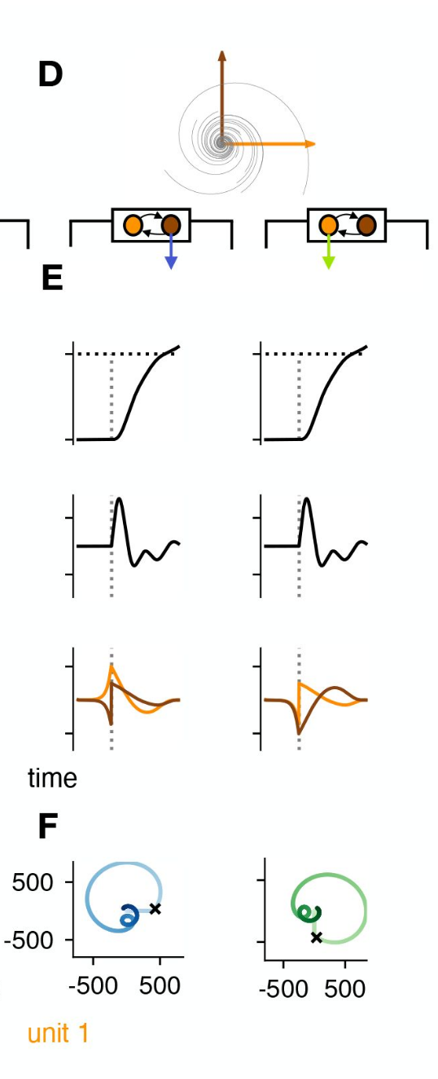
Computational “Why”: Optimality in
RNNs
• Preparation arises naturally in RNNs as an optimal strategy to minimize the complexity and energy of descending control inputs.
Schimel eLife 2023

Slide 14
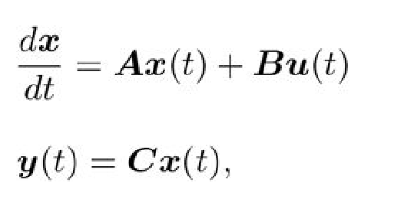
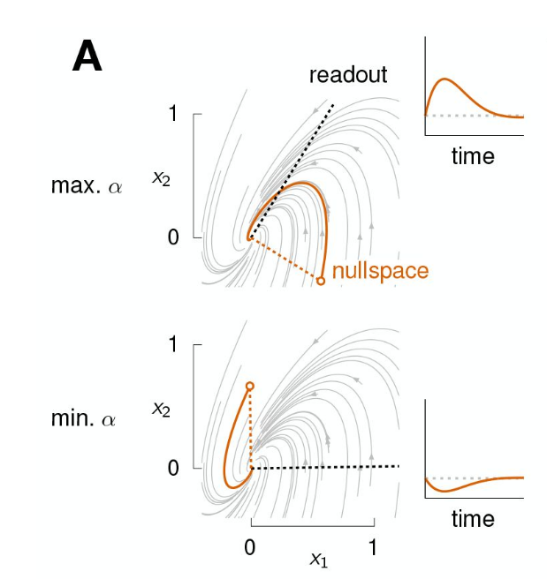

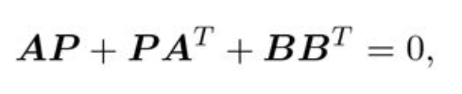
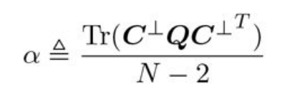
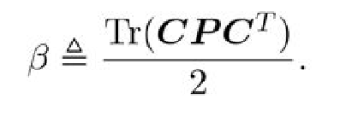
Observability vs. Controllability
• Reliance on preparation can be predicted by a network’s observability of the output nullspace relative to controllability.
Observability
Controllability
Schimel eLife 2023

Slide 15
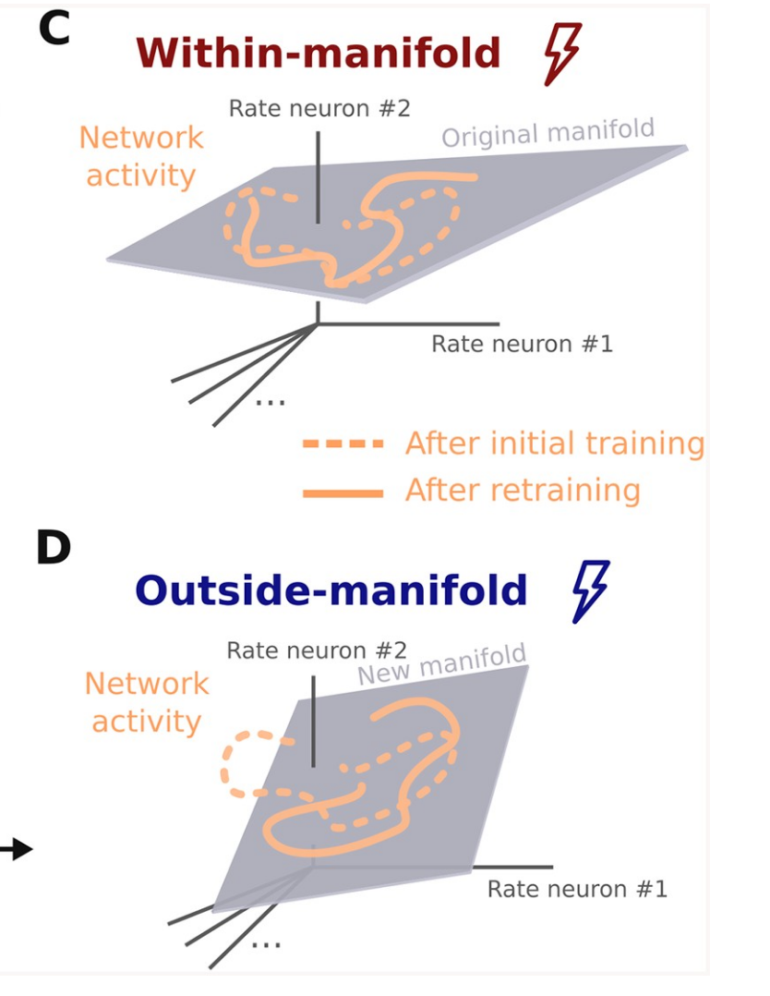
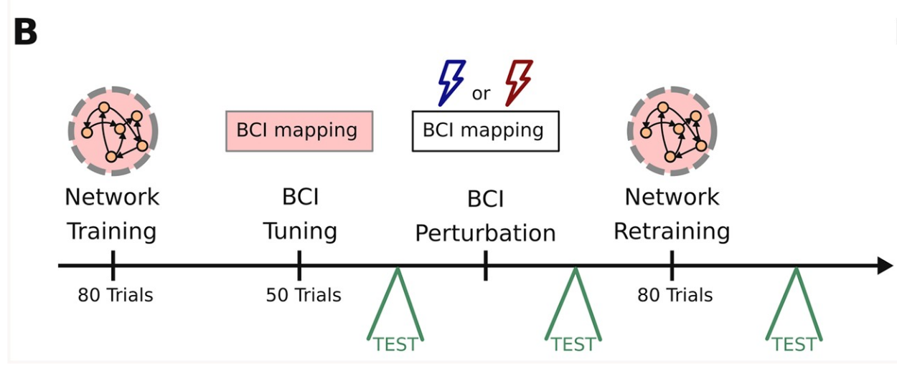
Learning Constraints: Within vs. Outside
Manifolds
• Within-manifold learning is fast; outside-manifold learning is slow and requires structural reorganization.
Feulner and Clopath PLOS Comp Biol 2021

Slide 16
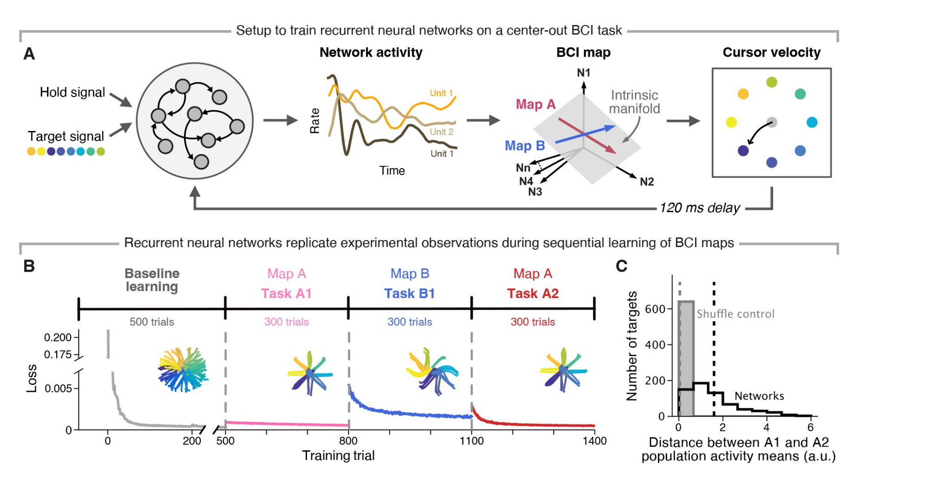
Signatures of Motor Memory
• Learning new tasks leaves memory traces and uniform shifts in the neural manifold, facilitating faster relearning.
Chang et al. eLife 2025

Slide 17
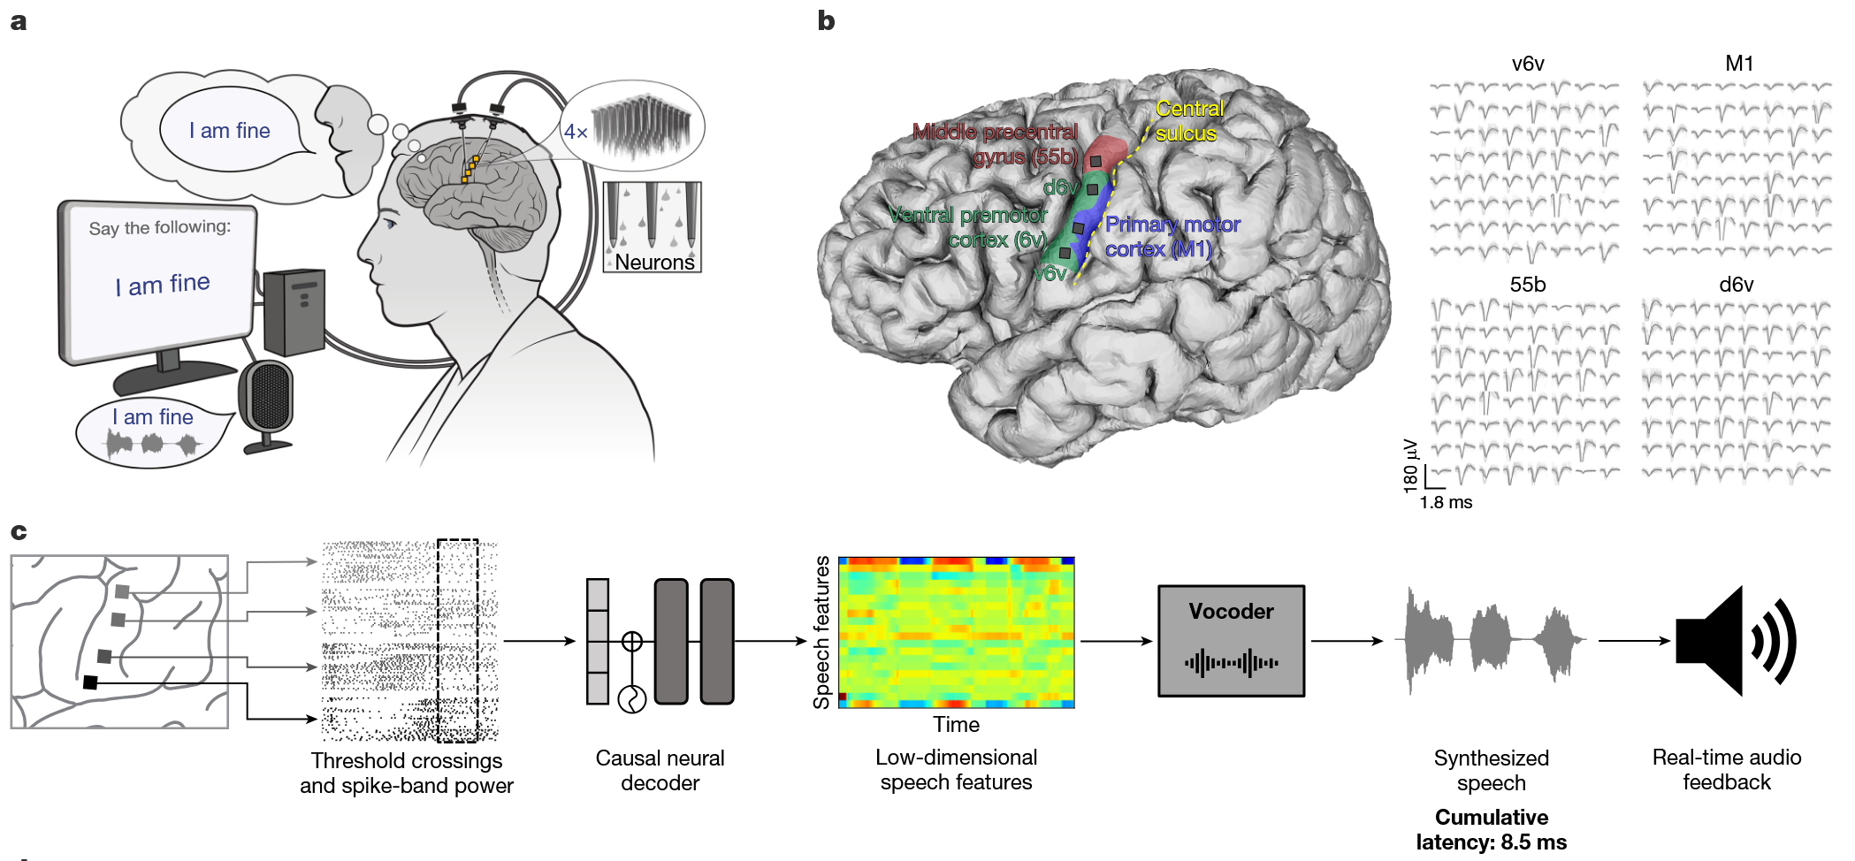
Instantaneous Voice Synthesis
• Manifold principles enable causal, 10ms-latency decoding of speech directly from vPCG recordings in patients with ALS.
Wairagkar Nature 2025

Slide 18
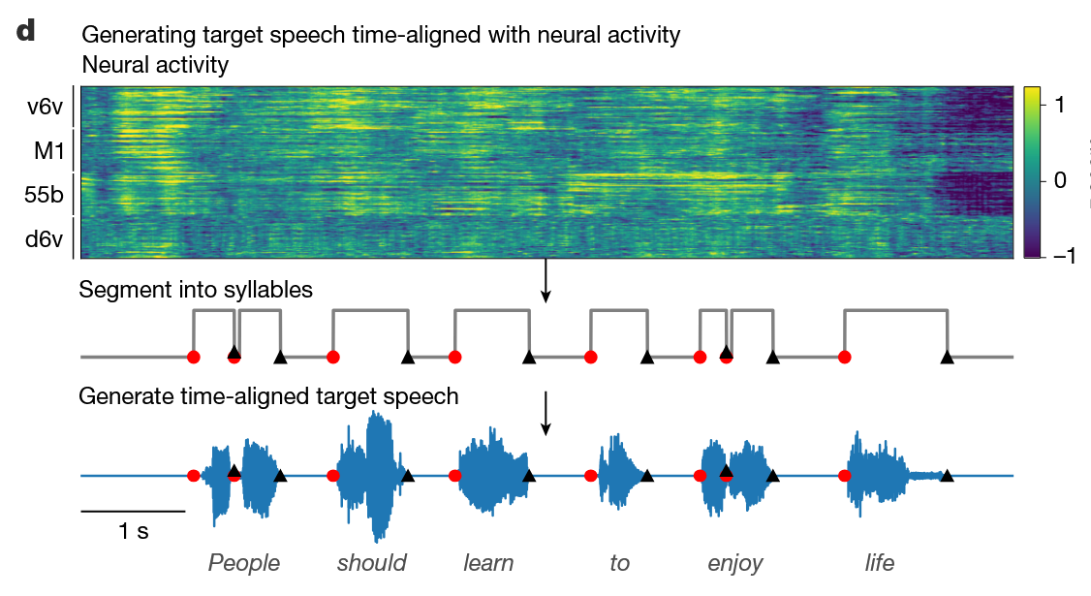
Articulatory Kinematic Manifolds
• Decoding high-dimensional neural activity into low-dimensional articulatory manifolds allows personalized voice synthesis.
Wairagkar Nature 2025

